Slide 1

Mobile App Usage Behavior Analysis Dashboard
-Power Bi

Slide 2

Dataset
User ID
Age
Gender
App Category (Social Media, Education, Entertainment, etc.)
Daily Usage Time (in minutes)
Usage Date
Screen Time Level

Slide 3

Problem Statement
1.People spend a lot of time using different mobile applications every day.
2.It is difficult to understand which app categories are used the most and least.
3.There is no clear view of user behavior based on age and usage time.
4.Manual analysis of mobile usage data is time-consuming and confusing.
5.This project solves the problem by analyzing mobile app usage data using Power BI.
This Photo by Unknown Author is licensed under CC BY

Slide 4

Dashboard Visuals
  Bar chart: App Category vs Usage Time
  Pie chart: Percentage of users by app category
  Table: User-wise usage details
  Slicers: Age, Gender, App Category
This Photo by Unknown Author is licensed under CC BY-SA-NC

Slide 5
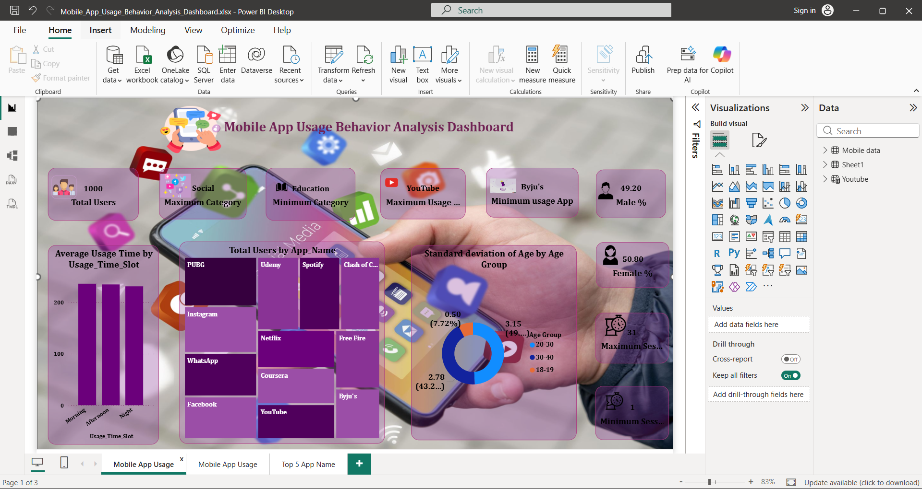

Slide 6
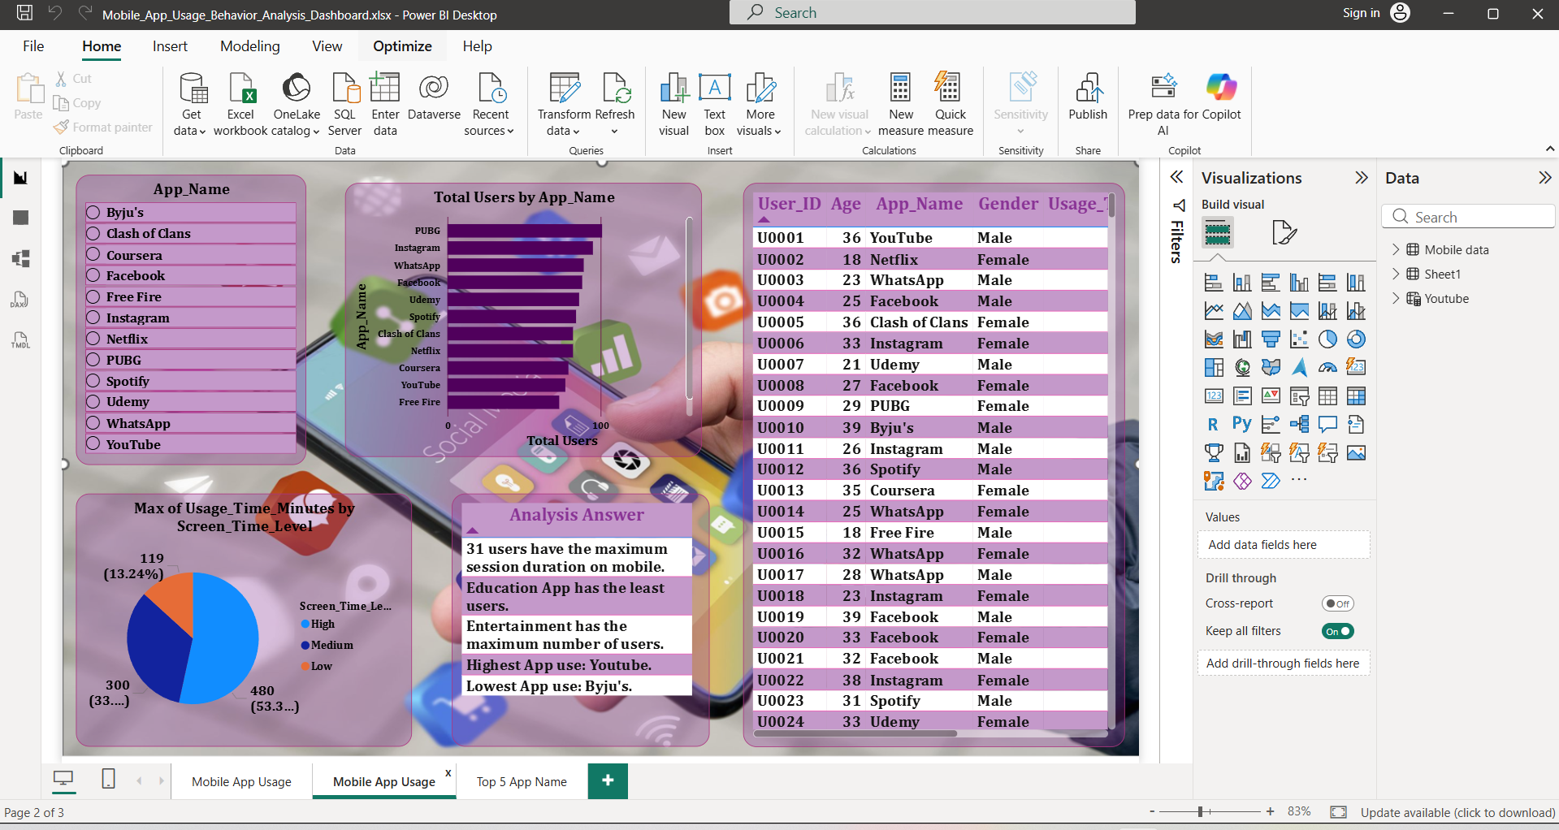

Slide 7
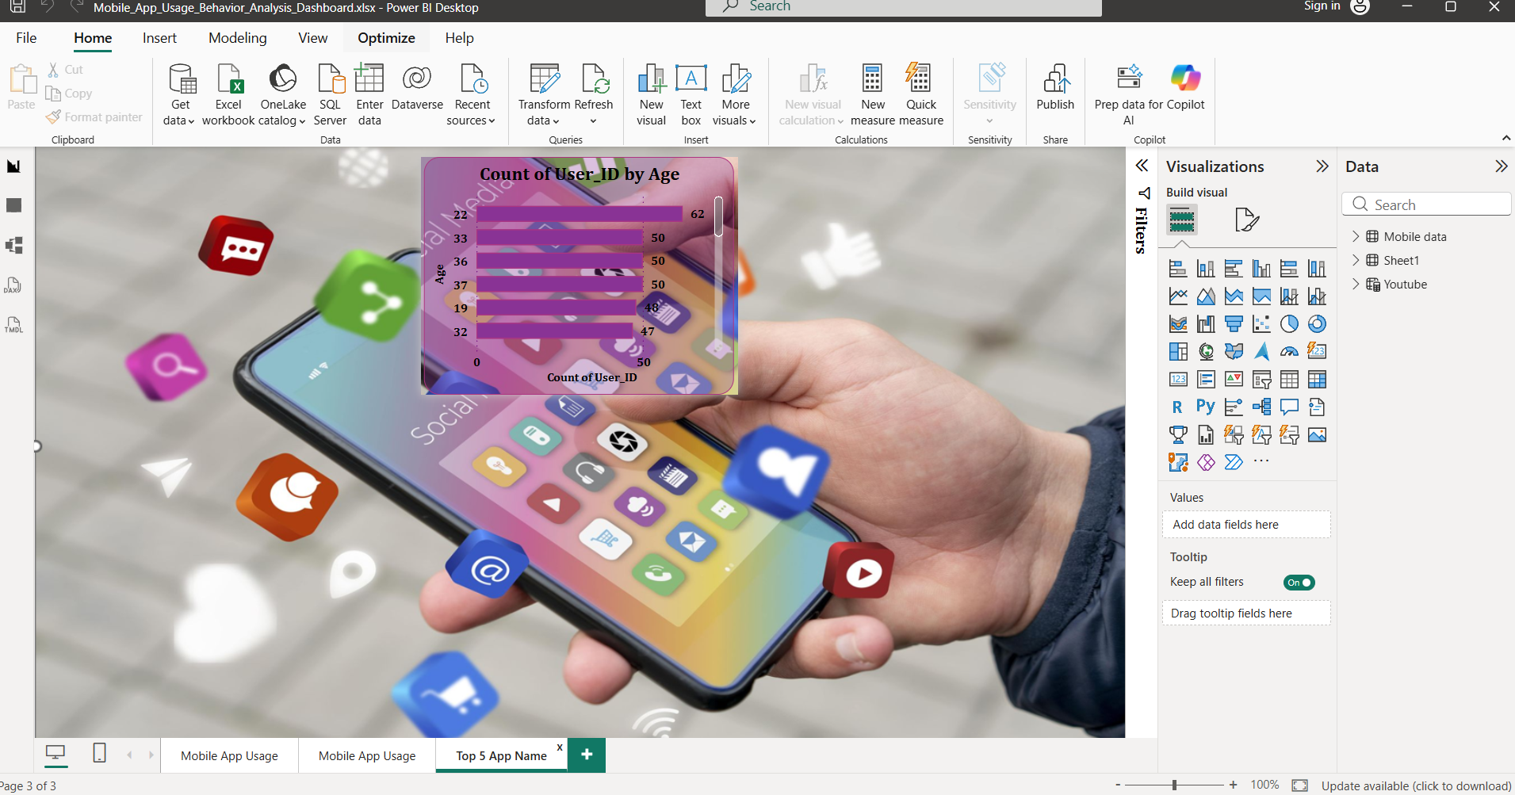

Slide 8
Conclusion
This project helps to understand mobile app usage patterns clearly. The dashboard provides useful insights for decision-making and user behavior analysis. Power BI makes the data easy to understand through visual representation.

Slide 9
Thank you
Elamathi.e
elamathi028@gmail.com.

